Slide 1

Working with R programming language
Pimonrat Tiansawat
2026

Slide 2
Let’s set our goals together
To be familiar with coding in R programming language (use R Studio)
To be able to look for common statistics and/or R package for what you want to do with your data
To be comfortable looking up for help about R

Slide 3
R and Statistics
R is NOT statistics.
R = an environment which many statistical techniques have been implemented.
Some techniques = built-in
Some are supplied as package (we will work with this)

Slide 4
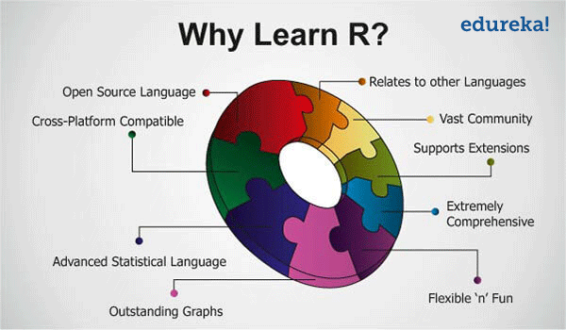
https://qph.ec.quoracdn.net/main-qimg-e6d077a37eb2d4033b8a49e41c1e7d01

Slide 5
Data types
6 data types in R
“a”, “biology” Character
2, 10.23, -1.8 Numeric
2L Integer
True, False Logical
1+4i Complex
62 6f 62 Raw

Slide 6
Data types
6 data types (modes) in R
“a”, “biology” Character
2, 10.23, -1.8 Numeric
2L Integer
True, False Logical
1+4i Complex
62 6f 62 Raw
Most of the time

Slide 7
Data structure
Data structures in R include
vector
list
matrix
data frame
factors
tables
Our focus

Slide 8

Lab format
Work at your own pace!
You will have worksheets and files.
Read the text and you will see
This is what you will type into R.
d<-c(88,5,12,13)
d1<-d[-c(1,5)]
Feel free to ask questions!

Slide 9
Additional R resources
R bloggers - https://www.r-bloggers.com/
R cookbook - https://rc2e.com/

